Slide 1

Restaurant Ratings vs. Obesity PROJECT - 01
Rutgers Data Science Bootcamp
By: Arjun Subramaniam, Brandon Wright, Fernando Monteiro, and Monika Raj
Notes:
Arjun

Slide 2

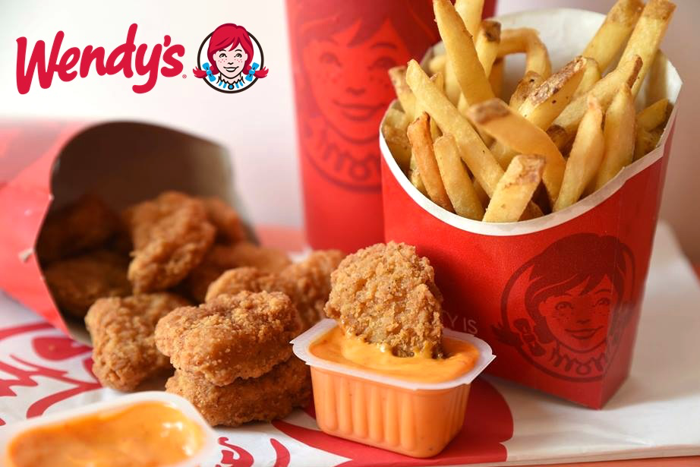
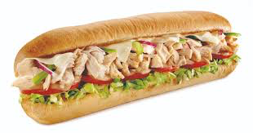
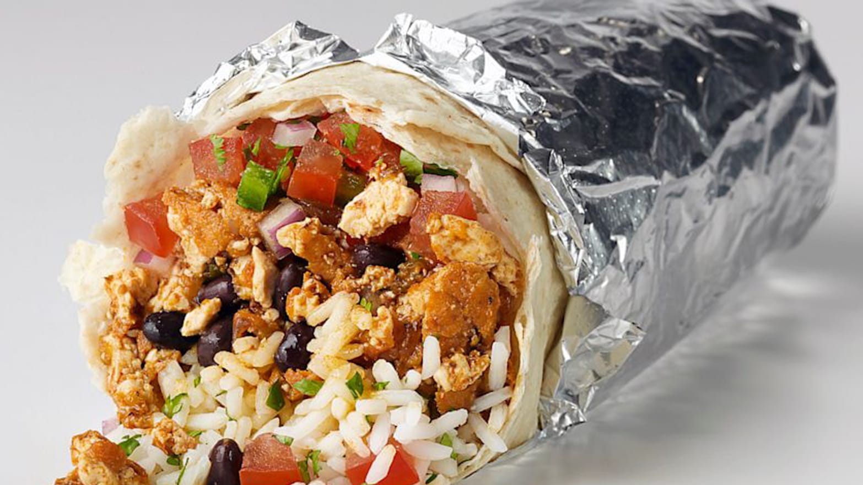
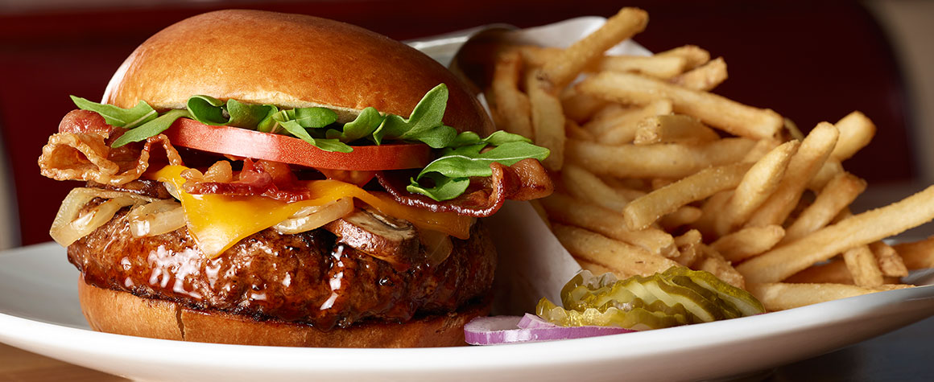
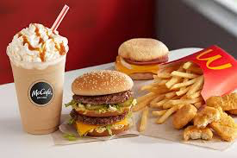
Project Inspiration
Our inspiration came from the desire to understand healthy and unhealthy food trends in the US.
Do the ratings of the restaurants correlate to how healthy the restaurants are?
Notes:
We analyzed mainly fast food restaurants that are considered Healthy and Unhealthy based on relevant resources.
some heatlthy inlcude panera, chipotle, Subway
Unhaelthy- mcd's wends burger
SuperSize Me inspired, unhealthy
What is exactly healthy and unhealthy?
Do bad food eating habits cause obesity?
Theses are questions we will address in the presentation

Slide 3
Healthy and Unhealthy Restaurants?
Healthy restaurant
Uses clean ingredients:
No MSG, or artificial trans-fat,
No preservatives or coloring,
No sweeteners or flavors , etc.
Unhealthy restaurants
Contains High sodium, High fats, High carbs
Injected with hormones
Notes:
Why Panera is considered healthy because they use clean ingredients ( no MSG, artificial trans fat or preservatives or coloring, sweeteners or flavors , etc.
Chipotle considered healthy because they serve food with Non –GMO. Ingredients are from farms all animals are raised without antibiotics or growth hormones.
Unhealthy we chose the top 4 from the article and used. Because they have high sodium, high fats, high carbs which all of these can lead to health issues such as high blood pressure, obesity etc. Even the quality of ingredients are injected with hormones and such.
which all of these can lead to health issues such as high blood pressure, obesity, heart disease etc.
Style of cooking is another factor Fried vs. Grilled (grilled being healthier fried being not)
Internet reviews and articles (from resources we determined what data to use)
Overall consensus within the group
Healthy restaurant review link https://www.thedailymeal.com/eat/americas-10-healthiest-chain-restaurants-0/slide-9
Unhealthy restaurant review link https://www.thetravel.com/we-present-americas-20-most-unhealthy-fast-food-chains/
Fast casual “ Healthy

Slide 4
How we determined “Healthy and Unhealthy” restaurants
Internet reviews and articles (from resources we determined what data to use)
Overall consensus within the group
Healthy restaurant review link https://www.thedailymeal.com/eat/americas-10-healthiest-chain-restaurants-0/slide-9
Unhealthy restaurant review link https://www.thetravel.com/we-present-americas-20-most-unhealthy-fast-food-chains/

Slide 5


Data Sources
Restaurant Data
Yelp API Data
Unhealthy records – appx: 4,240
Healthy records – appx: 3,136
Obesity data
CDC (center for disease control and prevention)
Approximately 59,000 records CDC
Notes:
Original API for USDA first gave us only hard alcohol info

Slide 6
Hypothesis (H0) and Null-Hypothesis(Ha)
Hypothesis:
Top 5 obese states will rate unhealthy restaurants higher
Bottom 5 obese states will rate healthy restaurants higher
Null Hypothesis:
Top 5 obese states will rate unhealthy restaurants lower
Bottom 5 obese states will rate healthy restaurants lower
Notes:
If the restaurant is “Healthy” then the customers will give it a higher rating
If the restaurant is “Unhealthy” then the customers will give it a lower rating
If the Bottom 5 states have higher ratings in the healthy obesity charts then it is True
For the restaurant’s customers that visit, in the most obese states, rate the unhealthy restaurants higher.
We’d like to test if the The ratings of unhealthy restaurants are different than the the ratings of the healthy restaurants.

Slide 7
Data Exploration & Cleanup
Began the extraction of the json files
Use of pandas and numpy in jupyter notebook
Requests and confirmation with pprints
Converting into data frames with only extracted relevant data

Slide 8
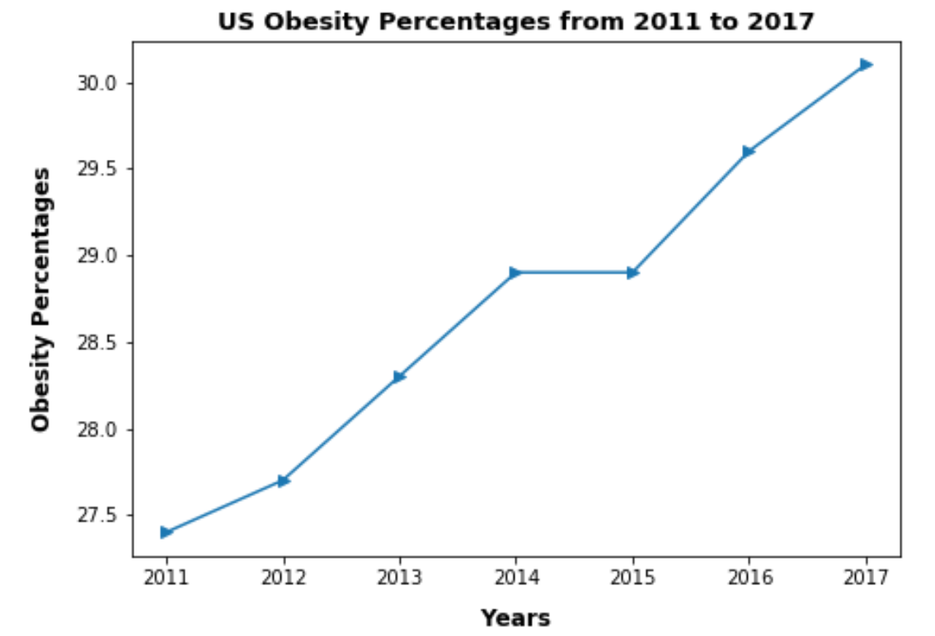
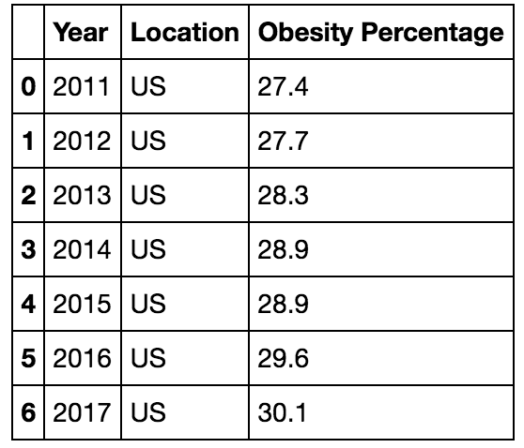
CDC Data Extraction
Notes:
We had to change the data frame because there was too much information given .
One data frame for the US summarized and the other Data dramas by state
For state top 5 2017 and bottom 5 by sorting the data frame, we just calculated the averages and plotted.
We also took the years but to narrow it down we limited it to just 2017 which was the most current
Cleaned Data taken from CDC data frame, top and bottom 5, 2017 states then once we got that we found the ratings.
Ratings data frame, taken from the yelp API data, imported for each chain. Calculated rating average for 5 states so we were able to merge the obesity data frame with the ratings data frame and create the scatterplot to display the data.
Brandon

Slide 9
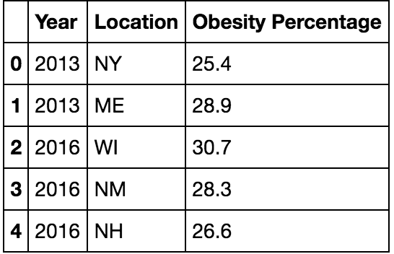
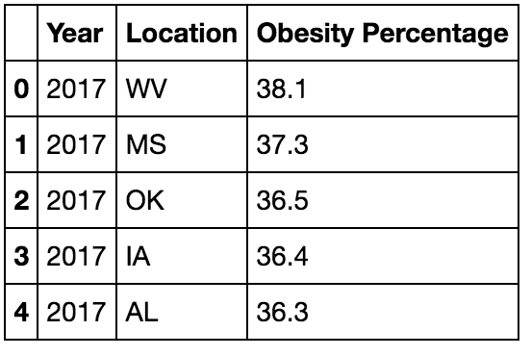
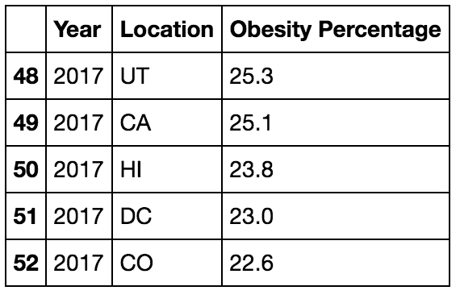
CDC Data Extraction
Top 5
Bottom 5

Slide 10
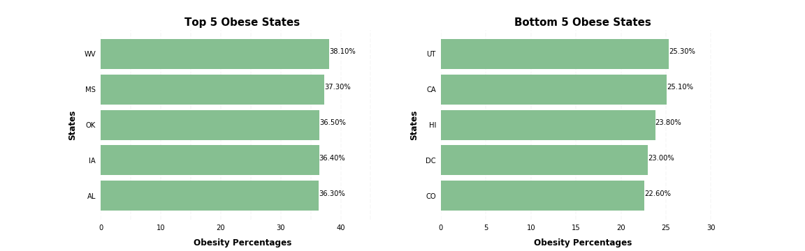
Obesity Rankings
Notes:
These are the top 5 states- West Virginia, Mississippi, Oklahoma, Iowa, Alabama
Theses are the Bottom 5 states- Utah, California, Hawaii, Washington DC, and Colorado

Slide 11
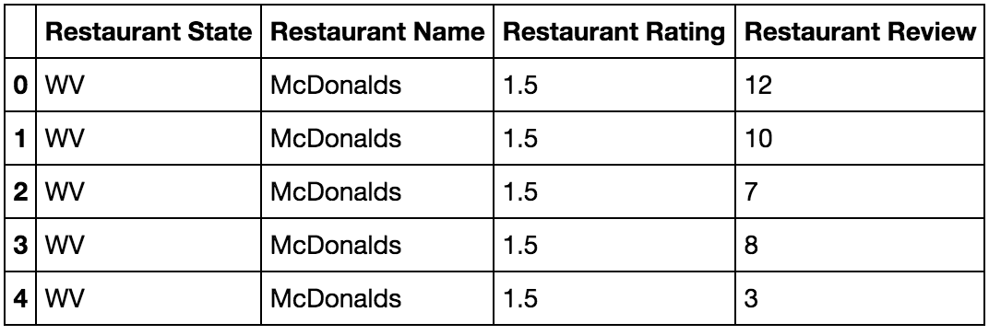
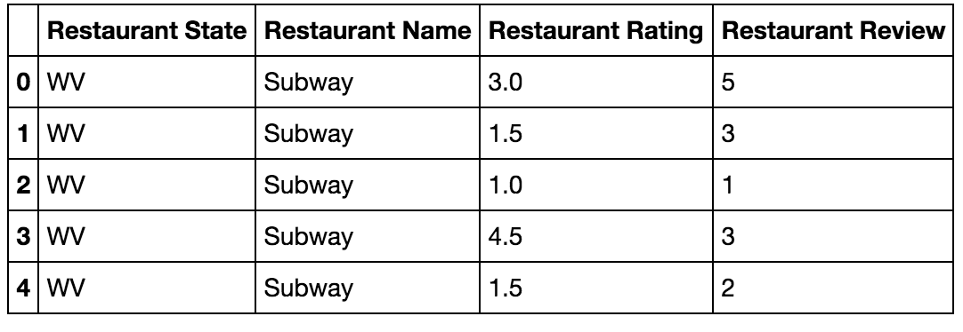
Yelp Data Extraction
Unhealthy
Healthy
Notes:
1. Unhealthy restaurants
Brandon

Slide 12
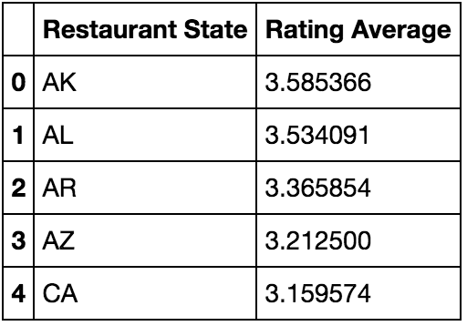
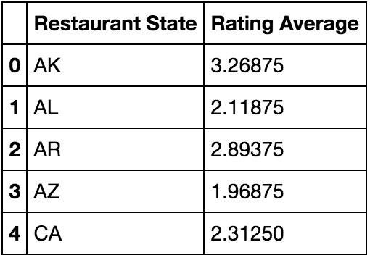
Yelp Data Extraction
Healthy
Unhealthy
Notes:
Brandon

Slide 13
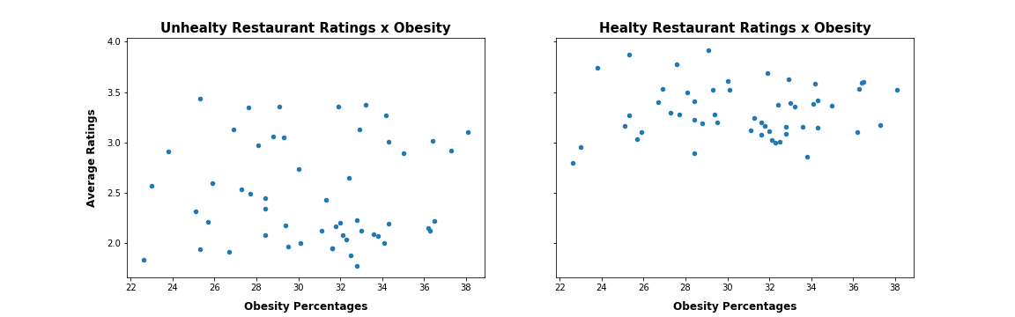
Average Ratings vs. Obesity % (US)
Notes:
This chart shows the average ratings vs the obesity percentages in the US.
We see that the healthy restaurants on average have higher ratings. Where the unhealthy restaurants have on average lower ratings.
What we were looking for is to see if there is a correlation between obesity percentages and the average ratings. What we a wanted to see was if the unhealthy restaurants ratings were ascending, (trendline going up) while the healthy restaurants trendline would be descending.

Slide 14
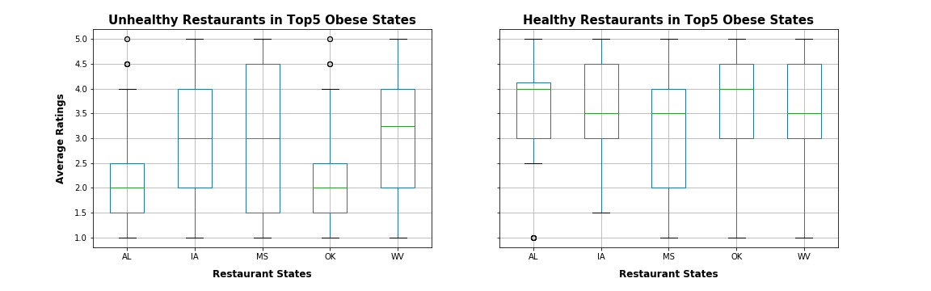
Top 5 Obese States Do unhealthy restaurants have greater ratings than healthy restaurants?
Notes:
Statistic value: 8.5263
P-Value- value: 0.00000000002
Based on the pvalue of the Ttest, we reject the null hypothesis, so Healthy and Unhealthy restaurants in Top5 Obese States have different rating averages.¶
Based on the statistic value of the Ttest, we notice that Healthy restaurants have greater Ratings than Unhealthy restaurants in Top5 Obese States.¶

Slide 15
Top 5 Obese States
Null Hypothesis: Unhealthy and healthy restaurants in Top 5 obese states have the same ratings
P value = 0
Statistic value = 8.5263
Conclusion: We reject the null hypothesis
Healthy and Unhealthy restaurants in Top 5 Obese States have different rating averages; healthy restaurants have greater Ratings than Unhealthy restaurants in Top 5 Obese States.
Notes:
Based on the pvalue of the Ttest, we reject the null hypothesis, so Healthy and Unhealthy restaurants in Top5 Obese States have different rating averages.
Based on the statistic value of the Ttest, we notice that Healthy restaurants have greater Ratings than Unhealthy restaurants in Top5 Obese States.

Slide 16
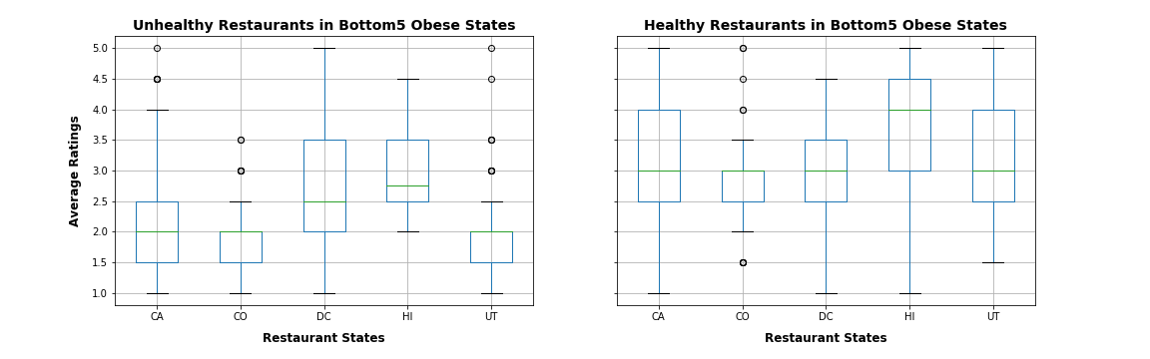
Bottom 5 Obese States Do healthy restaurants have greater ratings than unhealthy restaurants?
Notes:
Statistic value: 12.7561
P-value value: 0.0000000000000000

Slide 17
Bottom 5 Obese States
Null hypothesis: Unhealthy and healthy restaurants in Bottom 5 obese states have the same ratings
P value = 0
Statistic value = 12.7561
Conclusion: We reject the null hypothesis
Healthy and Unhealthy restaurants in Bottom 5 Obese States have different rating averages; healthy restaurants have greater Ratings than Unhealthy restaurants in Bottom 5 Obese States.
Notes:
Based on the pvalue of the Ttest, we reject the null hypothesis, so Healthy and Unhealthy restaurants in Bottom5 Obese States have different rating averages.

Slide 18
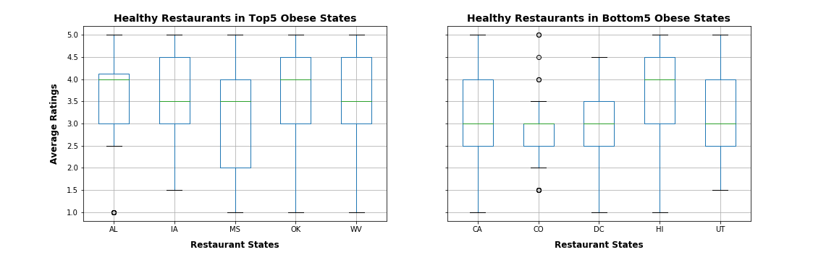
Comparative Analysis: Healthy restaurants
Notes:
Based on the statistic value of the Ttest, we notice that healthy restaurants have greater Ratings in Top5 obese states than in Bottom5 Obese States.

Slide 19
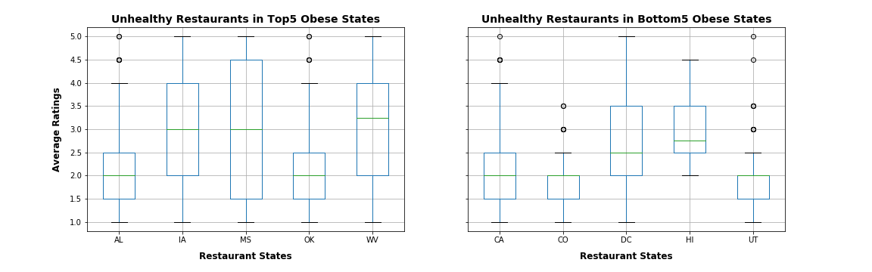
Comparative Analysis: Unhealthy restaurants
Notes:
Based on the statistic value of the Ttest, we notice that unhealthy restaurants have greater Ratings in Top5 obese states than in Bottom5 Obese States.

Slide 20
Discussing the obstacles
Gathering data was most difficult, deciding which API would be best for this project.
Determine what was ”healthy and unhealthy”
Merge conflicts
Notes:
We had selected a few different API’s ended up choosing the yelp API for our restaurant data and the CDC for out obesity data.
Initially we also wanted to study organic and nonorganic foods. But there were that would affect the data such as food consumption

Slide 21
Conclusion
Healthy restaurants are rated better despite rising obesity in the US.
Notes:
Implications of the findings :-

Slide 22
Thank You! EAT HEALTHY
Q&A?

